Slide 1
AIxplorer
A Smarter Google Scholar

Slide 2
Table of Contents
Problem Statement
Dataset
Retrieval Technique
Retrieval Performance Evaluation
Generation Using LLM
Verification of LLM Output Using Retrieved Documents
Citation Generation
Retrieval Augmented Generation
LLM Performance Evaluation without Retrieved Documents
LLM Performance Evaluation with Retrieved Documents

Slide 3

Problem Statement
Traditional conference paper search process:
overwhelming amount of information
literature review is a time-intensive process
AIxplorer:
retrieves relevant conference papers
LLM generates the output with the retrieved grounding documents

Slide 4
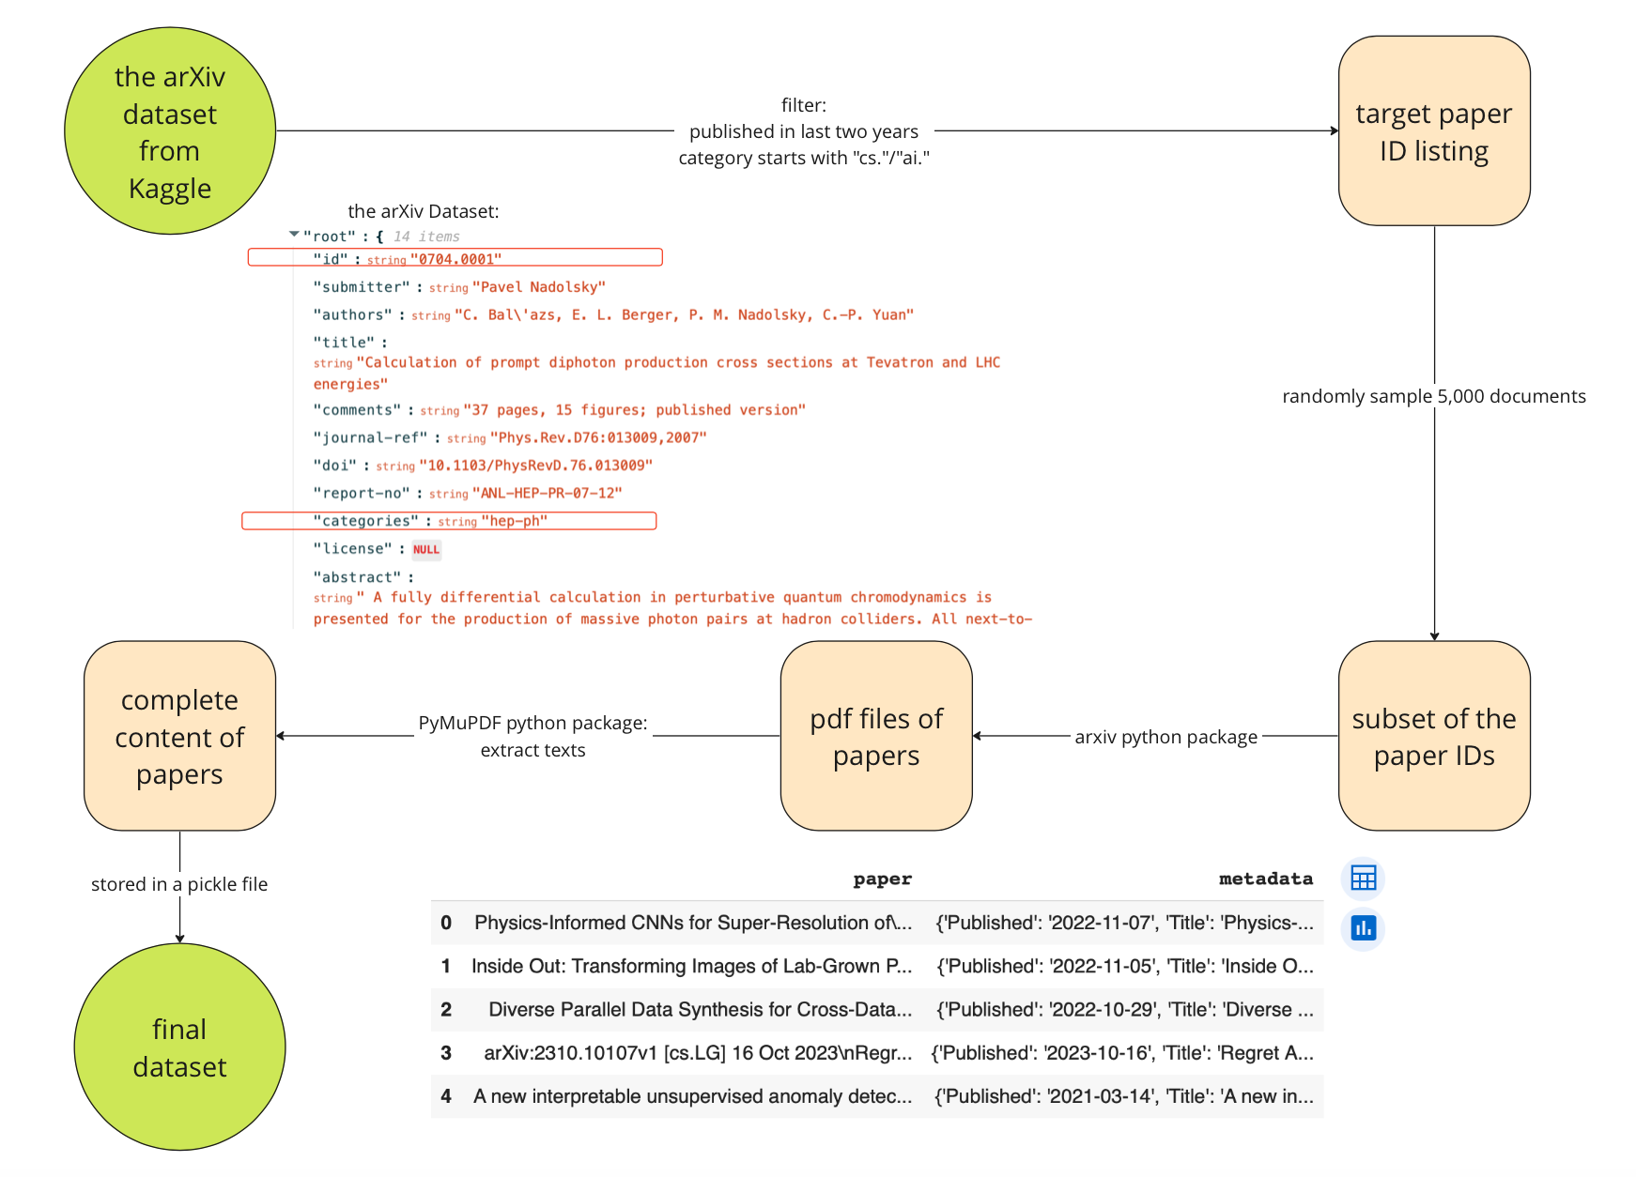
Dataset
Final dataset (5,000 papers)
computer science related
published in last 2 years
Notes:
We initiated our project with an extensive dataset from Kaggle. This dataset comprises metadata in JSON format, where each entry corresponded to an individual paper. However, the content of the papers was absent. so, we only crafted a targeted paper ID listing from here. The papers selected are all published in last two years and their categories start with the field name ”cs” or “ai”.
Given the constraints of computing resources, we streamlined our approach by creating a smaller subset of the dataset, randomly sampling 5,000 documents from the collection.
To obtain the complete content of these papers, we utilised the arXiv library to get pdf files and the PyMuPDF library to extract complete text content of each paper. The results are stored in a pickle file. As you can see in the picture, with each row represent one paper, the final dataset has two columns, one is the paper content, the other one is the metadata, including its title, published date, authors, etc.

Slide 5
Retrieval Technique
Model | Model Size (GB) | Embedding Dimensions | Vector Stores Created
all-MiniLM-L6-v2 | 0.13 | 384 | all-MiniLM-L6-v2_with_newline, all-MiniLM-L6-v2_without_newline,
all-mpnet-base-v2 | 0.44 | 768 | all-mpnet-base-v2_with_newline, all-mpnet-base-v2_without_newline
bge-base-en-v1.5 | 0.44 | 768 | bge-base-en-v1.5_with_newline, bge-base-en-v1.5_without_newline
bge-small-en-v1.5 | 0.13 | 384 | bge-small-en-v1.5_with_newline, bge-small-en-v1.5_without_newline
bge-large-en-v1.5 | 1.34 | 1024 | Failed to create vector stores due to limited computing resources.
ember-v1 | 1.34 | 1024 | Failed to create vector stores due to limited computing resources.
Cohere-embed-english-light-v3.0 | NA | 1024 | Failed to create vector stores due to limited computing resources.
Text Splitters:
RecursiveCharacterTextSplitter.from_tiktoken_encoder (chunk_size=400)
Vector Stores:
Faiss (gpu version not compatible with LangChain library)
Chromadb
Embedding Choices:
As shown in the right table
Notes:
Moving on to the retriever techniques.
we first used a RecursiveCharacterTextSplitter.from_tiktoken_encoder, to break down entire papers into chunks of manageable sizes.
In the realm of vector databases, we evaluated both Faiss and Chroma DB. Through our experiment, Faiss is faster but there’s compatibility issues with its GPU package. so we decide to go with chromadb.
For embedding choices, we investigated several top-rated models from the Massive Text Embedding Benchmark (MTEB) Leaderboard on HuggingFace, focusing on embedding dimensions between 384 and 1024. Additionally, we explored the impact of newline characters ('/n') by embedding datasets both with and without them. Through evaluation, it tends out bge_small_with_newline_characters outperforms others.

Slide 6
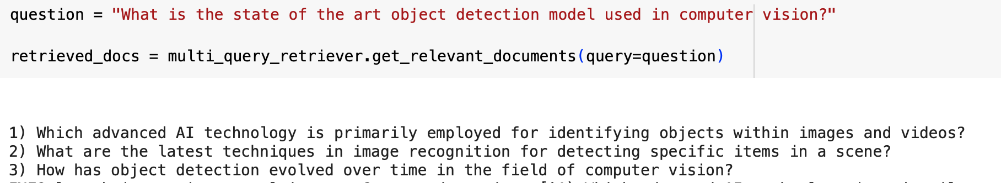
Retrieval Technique
Retrievers:
Similarity Search
Maximum Marginal Relevance Retrieval (MMR)
BM25
MultiQuery Retriever (Query Expansion)
Similarity Search
Maximum Marginal Relevance Retrieval (MMR)
Notes:
Regarding retrievers, our experiment included techniques like Similarity Search, Maximum Marginal Relevance Retrieval, and BM25. We also implemented the MultiQuery Retriever, which capitalizes on Large Language Models (LLMs) for query expansion.
As demonstrated here, a single query is expanded into three distinct inquiries, all serving the purpose of document retrieval.
Moreover, we tested two retriever types with the MultiQuery approach: MMR and Similarity Search. Thorough evaluation, Similarity Search turns out to be the best. We'll delve into more details on this shortly.

Slide 7
Retrieval Performance Evaluation
Evaluation Metrics
Mean Average Precision(mAP)
Mean Reciprocal Rank(mRR)
Mean Discounted Cumulative Gain(mDCG)
Mean Normalized Discounted Cumulative Gain(mNDCG)
newline character
Added/Removed
20 queries
Retriever
Vector store
Retrieved Documents
Encode
Labeling
Manually labeled
LLM labeled:
ask an LLM whether the document retrieved is relevant to the question 3 times
take the majority vote
Embedding
Labelling
Evaluate
Notes:
To evaluate on the performance of retrieval, we first generated 20 queries as the inputs for the retriever to retrieve docs from the vector store, after getting the retrieved documents, we will conduct labelling including both manual labelling and LLM-based labelling.
In the end, the performance is evaluated on the following 4 metrics, mAP, mRR, mDCG, and mNDCG. To improve the performance of retrieval, we varied the embedding among those 4 different models to encode the vector store. At the same time, we tried out 5 different retrievers. Another thing we have done is to remove the newline character to observe the difference in performance. so eventually experiments were conducted among different combination of embedding model and retriever.

Slide 8
Retrieval Performance Evaluation
Results
Best combination:
BAAI/bge-small-en-v1.5 with newline character
& Similarity search
Metrics calculated from manual labelling:
mAP: 0.848333333
mRR: 0.91
mDCG: 2.294667844
mNDCG: 0.890193541
Metrics calculated from LLM labelling:
mAP: 0.647569444
mRR: 0.691666667
mDCG: 1.716201672
mNDCG: 0.710704097

Slide 9
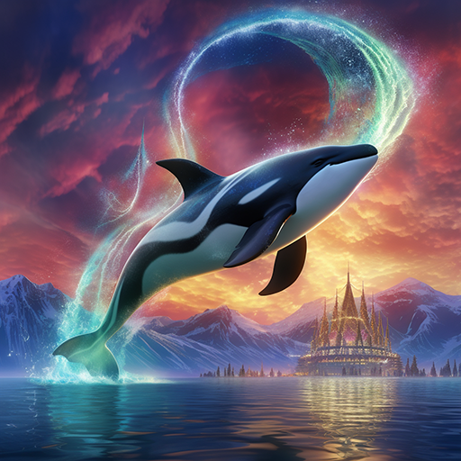
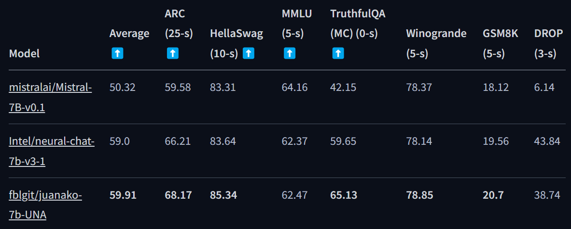

Generation Using LLM
LLMs Tested:
Mistral-7B-OpenOrca (60.17)
neural-chat-7b-v3-1 (61.59)
juanako-7b-UNA (67.46)
Notes:
For the Generation of responses using an LLM, we chose to use a 7b parameter model due to our lack of computational resources.
These are the 3 models that we selected for evaluation.
Mistral-7b_openorca
Neural-chat-7b
Juanako-7b
All of them are finstruction-tuned versions of Mistral-7B, a model that surpasses all other 7b parameter models in performance and even beating LLaMa2 13b in most benchmarks.
We selected the models after researching the model benchmark scores on a few LLM benchmarking leaderboards, one of them being the Open LLM Leaderboard on huggingface.
So in the brackets, you can see the current open llm leaderboard scores for each model, the comparison table is obtained from juanako’s huggingface repo and the scores for the model have increased since then.

Slide 10
Generation Using LLM
Vanilla
{question}
Chain of Thoughts
{question}
Please think step by step
LLMs Tested:
Mistral-7B-OpenOrca (60.17)
neural-chat-7b-v3-1 (61.59)
juanako-7b-UNA (67.46)
Role Playing
You are a helpful bot whose expertise lies in the field of computer science.
Please answer the question below to the best of your ability:
{question}
Prompting Methods:
Vanilla
Chain of Thoughts
Role Playing
Tree of Thoughts
Tree of Thoughts
Imagine three different experts are answering this question.
All experts will write down 1 step of their thinking,
then share it with the group.
Then all experts will go on to the next step, etc.
If any expert realises they're wrong at any point then they leave.
The question is: {question}
Temperatures:
{0.0, 0.25, 0.5, 0.75, 1.0}
Notes:
On top of experimenting with different LLMs, we also tested different Prompting methods, such as Vanilla, CoT, Role Playing and Tree of thoughts. ToT is a prompting method that was just published this year that asks the LLM to create a few personas and simulate the communication between them. The study claims that this prompting method surpasses CoT by a huge margin in terms of the correctness of the output.
Apart from experimenting with the different prompting methods, we also tested out different temperatures for each model, ranging from 0 to 1 to see if the LLM’s temperature affects the correctness of their output.

Slide 11
Verification of LLM Output Using Retrieved Documents
Verification Methods Attempted:
Rouge Score
Bleu Score
Meteor Score
LLM Verification
Vanilla (Self-consistent, n =10)
CoT (Self-consistent, n =10)
ToT (Self-consistent, n =10)
Notes:
For our next part, the verification of LLM output using retrieved documents, we tried out a few different verification methods, rouge score, bleu score, meteor score as well as verifying using another LLM, with and without self-consistency.

Slide 12
Verification of LLM Output Using Retrieved Documents
Verification Methods Attempted:
Rouge Score (0.029246¹, 0.045965²)
Bleu Score (0.162858¹, 0.179224²)
Meteor (0.192835¹, 0.221005²)
LLM Verification
Vanilla (Self-consistent, n =10)
CoT (Self-consistent, n =10)
ToT (Self-consistent, n =10)
Observations
Mistral-7B-OpenOrca performed the best for CoT prompting across all 3 evaluation metrics
Mistral-7B-OpenOrca has the highest number of top scores for each metric (6/12)
Temperature of 0 works the best in order to achieve the highest score per category when evaluated against retrieved documents
¹ Average score across all prompting methods, LLMs and Temperatures
² Top score across all the prompting methods, LLMs and Temperatures
Notes:
Here are some of the most significant results and observations we obtained.
Firstly for the results, the average score for each metric is the first number in the brackets and the top score for each metric is shown as the 2nd number in the brackets.
We found out that Mistral-7B-OpenOrca performed the best for CoT prompting across all 3 evaluation metrics.
Mistral-7B-OpenOrca also has the highest number of top scores for each metric.
Lastly, we found out that the temperature of 0 worked the best for the LLMs when evaluated against retrieved documents as the LLMs tend to achieve the top scores with it.

Slide 13
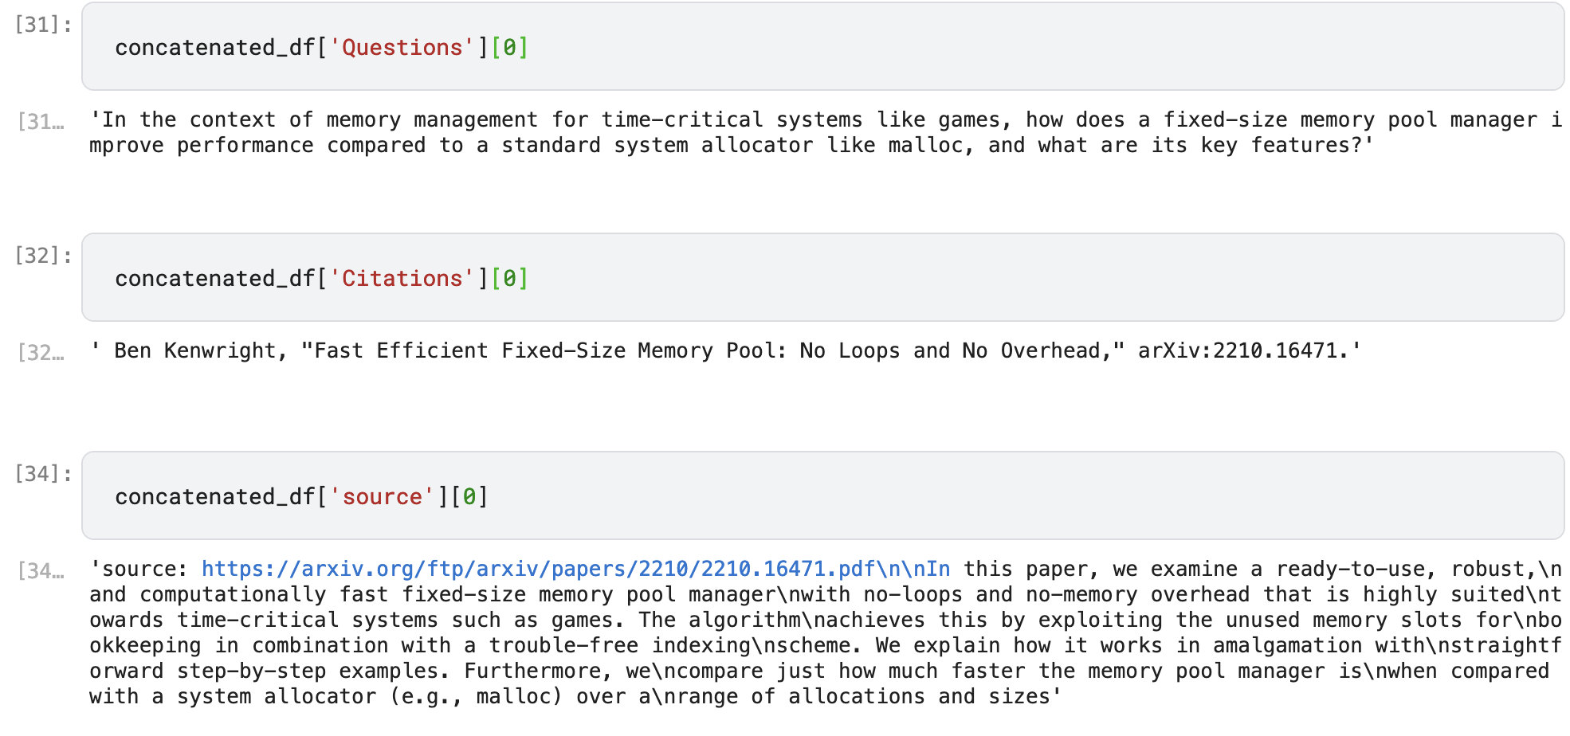
Citation Generation
Related Documents Retrieval (top 5 relevant docs)
BAAI/bge-small-en-v1.5 + MultiQueryRetriever
temperature = 0
temperature = 0.75
BAAI/bge-small-en-v1.5 + vector_store.as_retriever(search_type="mmr")
temperature = 0.75
temperature = 0.5
neural-chat-7b-v3-1 + Role Playing Prompt method (cs expert)
temperature = 0: not generating citations at all, simply repeat provided question and docs
temperature = 0.75: did not follow APA style all the way as stated in the prompt, but citations basically align with source
temperature = 0.75 + example of APA citation in prompt: followed APA style most of the time as well as satisfying correctness, best performance

Slide 14
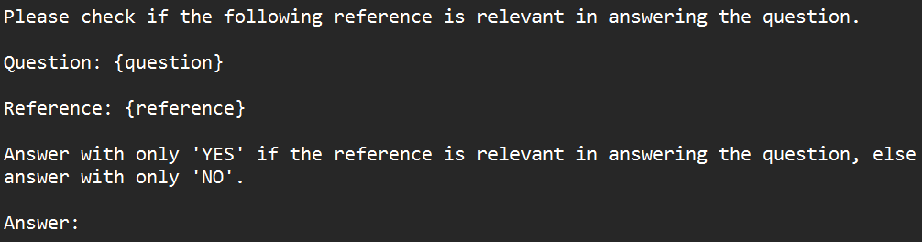
Retrieval Augmented Generation (RAG)
Method Used for Document Verification
Use an LLM to evaluate a document is relevant to the question (with self-consistency)
Prompt Template:
Notes:
For the retrieval augmented generation part of our project, the method we used for verification of the retrieved documents is by using an LLM to evaluate if a document is relevant to the question, with self-consistency.
This is the prompt template used for our verification process.

Slide 15
Retrieval Augmented Generation (RAG)
Method Used for Document Verification
Use an LLM to evaluate a document is relevant to the question (with self-consistency)
RAG Methodology:
Retrieve top-5 documents from Vector Database
Verify if the retrieved documents are relevant
Feed the retrieved documents alongside the question into the 3 LLMs, using the 4 prompting techniques + 5 different temperatures:
Vanilla
Chain of Thought
Role Playing
Tree of Thoughts
Notes:
For our retrieval augmented generation methodology, we first retrieve the top 5 documents from our vector database, then we verify if the documents are relevant using the method specified above. Lastly, we feed the questions and documents into the 3 LLMs, using the 4 prompting methods and 5 different temperatures to find out which combination manages to achieve the best results.

Slide 16
Retrieval Augmented Generation (RAG)
Vanilla
Please answer the following question using the provided references. If you do not know the answer, just respond with I don't know.
Question: {question}
References:
- {reference₁}
...
- {reference_{n}}
Answer:
CoT
Please answer the following question using the provided references. If you do not know the answer, just respond with I don't know.
Question: {question}
References:
- {reference₁}
...
- {reference_{n}}
Please think step by step.
Answer:
Notes:
Here are the prompt templates we used for the retrieval augmented generation. For the vanilla prompt, we just requested that the LLM tell us that it does not know if it is unable to answer the question using the provided references, for CoT, we added one more line “Please think step by step” right before the answer.

Slide 17
Retrieval Augmented Generation (RAG)
Role Playing
You are a helpful bot whose expertise lies in the field of computer science.
Please answer the question using the references provided to the best of your ability.
Question: {question}
References:
- {reference₁}
...
- {reference_{n}}
Answer:
ToT
Imagine three different experts are answering this question using the references provided.
All experts will write down 1 step of their thinking,
then share it with the group.
Then all experts will go on to the next step, etc.
If any expert realises they're wrong at any point then they leave.
The question is: {question}
References:
- {reference₁}
...
- {reference_{n}}
Answer:
Notes:
For Role Playing, we asked the LLM to act as an expert in the field of computer science and lastly for ToT, we asked the LLM to create 3 different personas to discuss what is the correct answer amongst themselves and return the correct answer to the user.

Slide 18
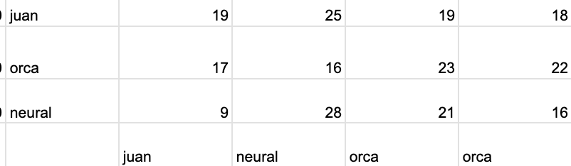
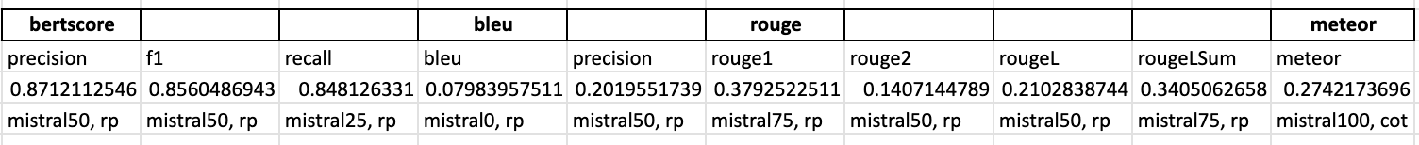
LLM Performance Evaluation without Retrieved Documents
max votes(10/20):
mistral_openorca with temperature of 0.75, ToT prompt
LLM self-evaluation
provide question, generated response and ground truth to LLM, ask it to decide whether the response matches the ground truth
role playing prompt method - tell LLM it is a teacher whose job is to mark student’s answer, if match, output ‘yes’, otherwise output ‘no’
use Mistral-7B-OpenOrca, neural-chat-7b-v3-1 and juanako-7b-UNA, then conduct a voting of their marks, if yes >= 2, then it is considered match, otherwise not.
evaluated all responses against ground truth and gpt4-generated answers.
Score Metrics
Mistral-7B-OpenOrca!

Slide 19
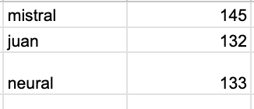
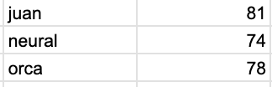
LLM Performance Evaluation with Retrieved Documents
LLM Evaluation
overall scores increased by 1.6 times (around 80/400 -> 130/400)
Mistral-7B-OpenOrca with 1.0 temperature, CoT prompt & neural_chat_3.1 with 0.5 temperature, CoT prompt works the best (11/20)
Score Metrics
BERT Precision: neural_chat_3.1 1.0 - 0.8706
BERT Recall: neural_chat_3.1 1.0 - 0.8912
BERT F1: neural_chat_3.1 1.0 - 0.8791
BLEU Score: juanako 0.0 - 0.2093
BLEU Precision: juanako 0.0 - 0.2343
ROUGE-1: juanako 0.25 - 0.3944
ROUGE-2: juanako 0.0 - 0.2640
ROUGE-L: juanako 0.0 - 0.3206
ROUGE-Lsum: juanako 0.0 - 0.3323
METEOR: juanako 0.0 - 0.4178
juanako-7b-UNA
Notes:
vanilla
BERT Precision: neural_chat_3.1 1.0 - 0.8706
BERT Recall: juanako 0.0 - 0.8912
BERT F1: neural_chat_3.1 1.0 - 0.8791
BLEU Score: juanako 0.0 - 0.2093
BLEU Precision: juanako 0.0 - 0.2343
ROUGE-1: juanako 0.25 - 0.3944
ROUGE-2: juanako 0.0 - 0.2640
ROUGE-L: juanako 0.0 - 0.3206
ROUGE-Lsum: juanako 0.0 - 0.3323
METEOR: juanako 0.0 - 0.4195​​
cot
BERT Precision: juanako 0.0 - 0.8635
BERT Recall: juanako 0.0 - 0.8912
BERT F1: juanako 0.0 - 0.8767
BLEU Score: juanako 0.0 - 0.1420
ROUGE-1: juanako 0.0 - 0.3654
ROUGE-2: juanako 0.0 - 0.2374
ROUGE-L: juanako 0.0 - 0.2954
ROUGE-Lsum: juanako 0.0 - 0.3087
Meteor Score: juanako 0.0 - 0.4195​​
tot

